Slide 1
2024 South Carolina Agriculture Business Plan Assistance
By: Matson Consulting

Slide 2
What is a business plan
A roadmap that outlines:
What your business is
Your goals (short and long term)
How you will make money
How you will grow
Notes:
A business plan is like a roadmap for a business. It's a document that outlines what a business is all about, its goals, how it will make money, and how it will grow. It is kind of like a game plan that helps business owners make informed decisions and attract investors. It's important because it helps keep things organized and gives a clear direction for the business.

Slide 3
For example: a Lawn care business
Are you wanting to make enough for fun money through high school or start a career
How much do you need to charge to make money
Do you have a paid-off lawn mower
Are your parents paying for the gas and new blades
How will you market your business
Social media
Word of mouth through your neighborhood
Short term or long term
Notes:
For example, if you were to own a lawn care business, there are many different topics that need to be thought about. For starters, is this a short term business to make extra money for the upcoming summer. Or are you planning to make this a life long career? Secondly, how much money do you need to make in order to make a profit? If you are buying a lawn mower you will be responsible for the payments. You will also be responsible for changing blades regularly and fuel costs. Lastly, how will you get customers for your business. There are many different marketing tactics that are proven beneficial, including social media and word of mouth.

Slide 4
What is your product/Service
Notes:
When you're explaining your products and services, you have to keep it simple and fun. Think about what you're offering, whether a product or a helpful service. Choose something you actually enjoy doing! When you're excited about what you're offering, it's easier to explain and get others excited too.

Slide 5
Strengths & weaknesses
Strengths
What you do well
What separates your business from others
Internal and external resources
Weaknesses
Things your business lacks
What other businesses do better than you
Limited resources
Notes:
Let’s pretend you own a flower business. It is important to figure out your strengths & weaknesses. Does your flower shop have a fast turnaround time compared to others in the local area? Do you have internal resources, such as someone who has worked in a flower shop before and are you allocating them well? Realizing what area your business is thriving or slacking in, will give you a better picture of areas you need to work on.

Slide 6
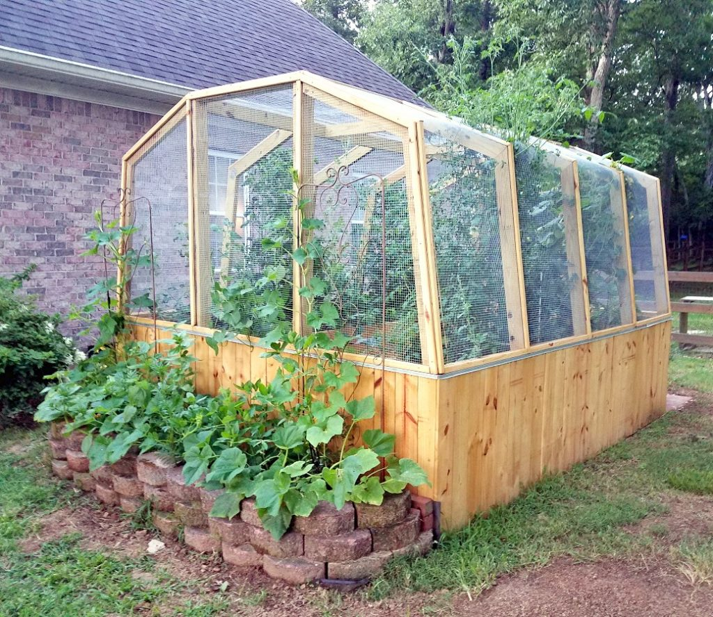
Opportunities & Threats
Opportunities
Few competitors
Emerging need for your product/service
Large positive media coverage
Threats
Emerging competitors
Changing environment
Negative media coverage
This Photo by Unknown Author is licensed under CC BY-NC-ND
Notes:
Now let's say you are building a backyard greenhouse, and you are selling the produce locally. What opportunities or threats do you need to think about? Is your structure going to protect your plants. What will you do if your crop is ruined? Building relationships with other businesses in your local area can help. Writing everything out will help give you a clear picture of what can either help grow or hinder your success. Are there a lot of similarly structured competitors that are offering the same products as you? If so, it would be a great opportunity to try and work together to grow both of your businesses. Is there a larger market for your products? With a larger market, you have the opportunity to branch out with trying new vegetables. Are you able to gain positive media coverage in order to attract more customers? Building relationships with local farmers' markets or news stations can be a great addition to the marketing you are already doing.

Slide 7
How are you going to fund your business
Notes:
It is very important to know how you're going to fund your business. You can consider a few options like grants, investors, or even using your own savings. Grants are like free money that you can apply for if your business aligns with certain criteria. Investors are people who believe in your idea and provide funding in exchange for a share of your business. And of course, you can always use your own savings if you have some. It's all about finding the best fit for your business and your goals. Just remember, planning ahead and knowing your options will help you make the right choice.

Slide 8
How will you allocate resources
Financial & Informational Resource Examples:
Parent
Teacher
Someone already in the same business area
Research
Notes:
Allocating resources is also important. You can reach out to your parents for financial support, teachers for guidance, someone in a similar business for advice, or even friends for help. It's all about building a strong network and utilizing the resources around you.

